Slide 2
Title: Unleashing the Power of C4Dynamics: A Framework for Object Detection and Tracking
I. Introduction
A. Brief overview of the importance of object detection and tracking systems
B. Introduce C4Dynamics as a framework for developing, analyzing, and investigating algorithms for these systems
C. Highlight the focus of the presentation on the capabilities of C4Dynamics using tank video as an example
II. C4Dynamics Framework
A. Definition and core components
1. Object detection
2. Object tracking
3. Algorithm analysis
B. Flexibility and adaptability of the framework
1. Compatibility with various data sources
2. Support for real-time and offline processing
contact information for further inquiries or collaboration opportunities

Slide 3
III. Object Detection Capabilities
A. Overview of C4Dynamics' object detection features
B. Demonstration of C4Dynamics' object detection performance
1. Detection accuracy
2. Speed and efficiency
C. Use cases and applications
1. Surveillance
2. Autonomous vehicles
3. Industrial automation
IV. Object Tracking Capabilities
A. Introduction to C4Dynamics' object tracking capabilities
B. Demonstrating C4Dynamics' object tracking performance
1. Multiple object tracking
2. Occlusion handling
3. Long-term tracking

Slide 4
C. Real-world applications
1. Traffic management
2. Sports analysis
3. Crowd monitoring
V. Algorithm Analysis and Investigation
A. Discuss C4Dynamics' tools for analyzing and fine-tuning tracking algorithms
B. Highlight the importance of algorithm investigation for improving system performance
C. Showcasing examples of algorithm improvements through C4Dynamics
VI. Using C4Dynamics with Tank Video
A. Present the specific use case of analyzing tank video
B. Showcase how C4Dynamics enhances object detection and tracking in this context
C. Highlight the advantages and unique features when dealing with tank video

Slide 5
VII. Case Studies and Success Stories
A. Share real-world case studies or success stories using C4Dynamics
B. Discuss the impact and benefits of the framework in these cases
C. Include quantitative results and qualitative feedback from users
VIII. Future Developments and Roadmap
A. Discuss future enhancements and updates planned for C4Dynamics
B. Seek feedback and collaboration opportunities with the audience
IX. Conclusion
A. Summarize the key takeaways from the presentation
B. Reiterate the significance of C4Dynamics in object detection and tracking
C. Open the floor for questions and discussion

Slide 6
X. Q&A Session
A. Engage with the audience and address their questions and inquiries
XI. Thank You
A. Express gratitude for the audience's time and participation
B. Provide contact information for further inquiries or collaboration opportunities

Slide 7
Frame | Track (right) | Tank (left) | Notes
0 | 0 | --
1 | 0 | 1 | How each of them was detected?
2 | 0 | 1
3 | 0, 1 | -- | The tank wasn’t detected? The tank detected but there was an error in reading its box. the model detected the track with two different objects (which?) and didn’t detect the tank? If it wasnt a kneighbors error then we should have seen two new tracks on the ocjects. Then I knew that the detector correctly found the spots but the k didn’t assigned them correctly. but what we see here is two known traks belonging to different objects. Suspectious to wrong k neibhgoubs association.
 | 0, 1 | -- | also, this switch of trkid 1 should be seen in the range plot.
 | -- | 0, 1
 | -- | 0, 1
 | -- | 0, 1
 | 2? | 0, 1, 3?
 | -- | 0, 3
 | -- | 0, 3
 | 3 | 0
 | 2 | 0
 | 2 | 0
 | .. | .. drifting

Slide 8
Now everything in the previous table should be presented with c4d graphs.

Slide 9
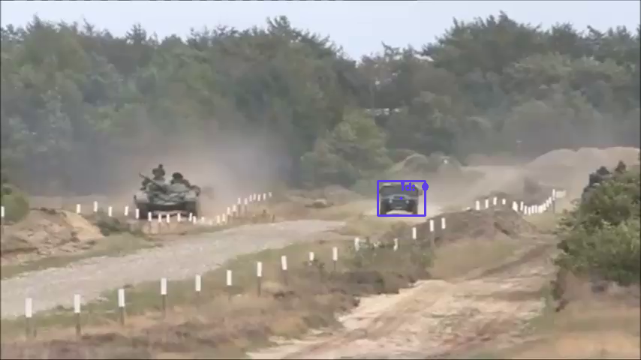
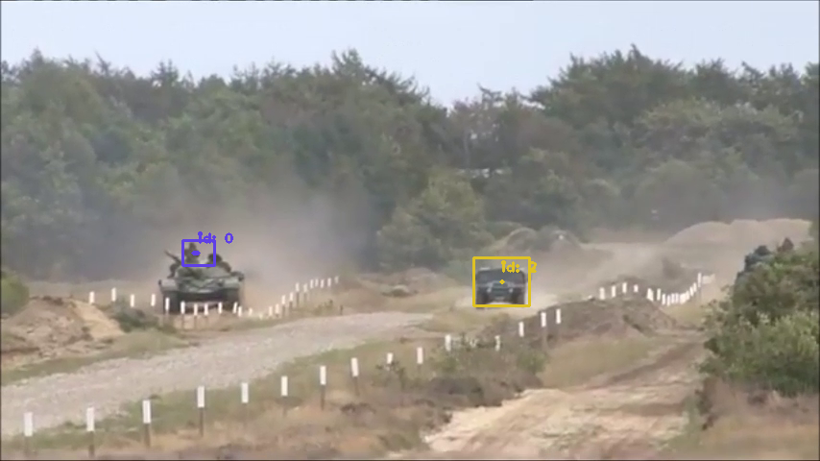
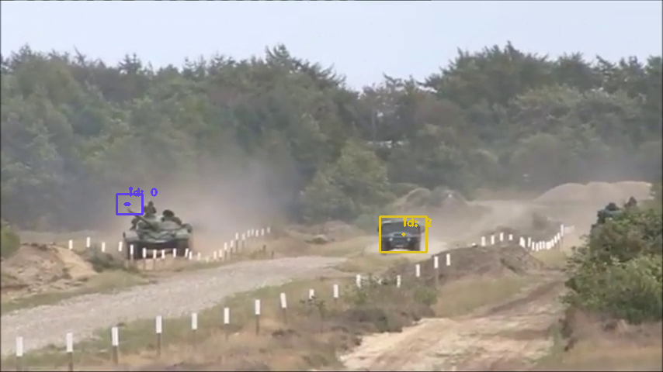
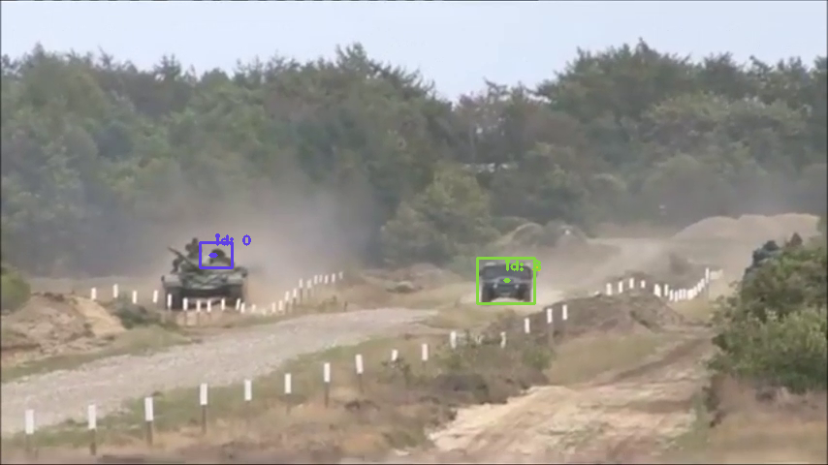
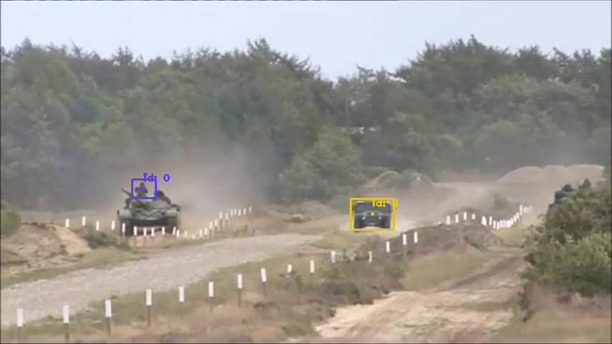
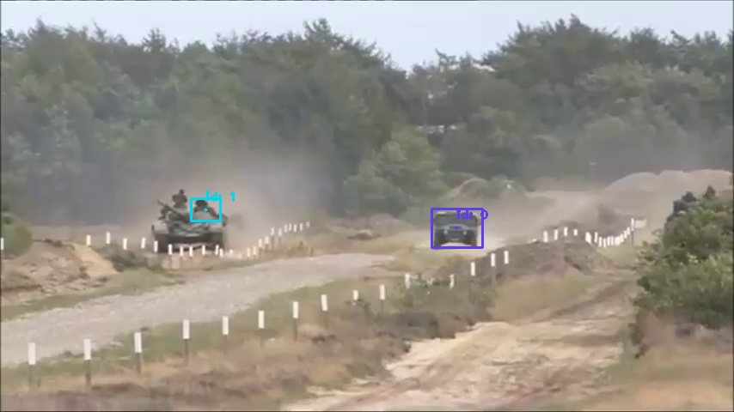

Imagine it in motion

Slide 10
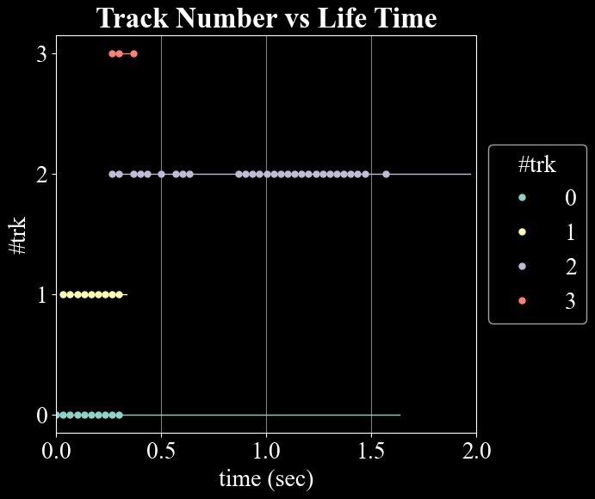
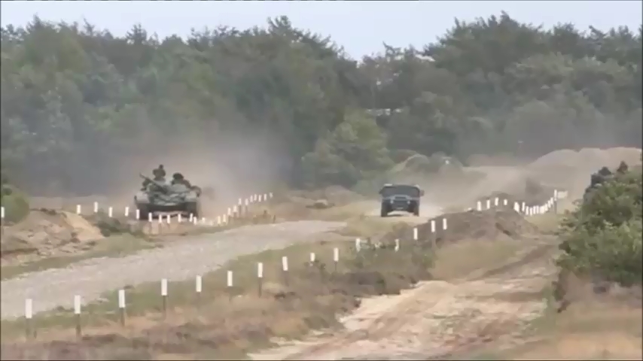
General imporessions
We got two objects but we have 4 trk ids.
Two trk id run for first 300msec and new trk id runs for the remaining playback.
4 different track-ID’s to two objects

Slide 11
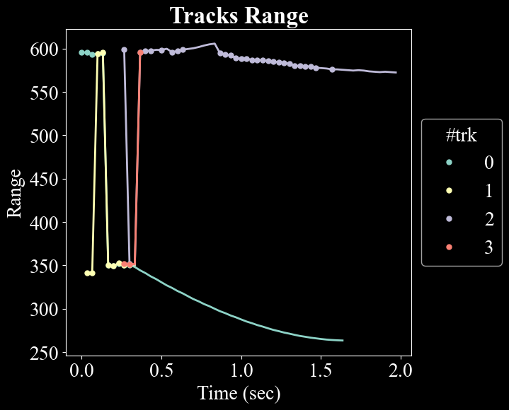
Imporessions
This range is in piexles (not a geographical)
After some messy at the first 300msec there was a satbiliziation about two objects (which is pretty correct)
But as opposed to the upper track, the bottom track has no detectons on it (fileed dots) and is continuing only with its dynamical (linear) model as the Kalman predicts.
Why one object continued on prediction and 2 other not?
This figure represents the (pixel) position of the objects.
It’s obvious that the confusion \ all the messy between the two objects occurred within the first 300msec.
Stabilization time.

Slide 12
4 different track-ID’s to two objects

Slide 13
positions figure.
After stabilization time, the system destinction correctly between two objects.
but, as opposed to track 2 (purple), track 0 (green) has no detectons on it (fileed dots).
This means that it continues only by the Kalman predictions as given by its dynamical (linear) model.
Stabilization time.

Slide 14
stabilization time
The messy association may related to one of two:
1 Bad association of the K-neighbours algorithm.
2 or,
Stabilization time.

